Slide 1

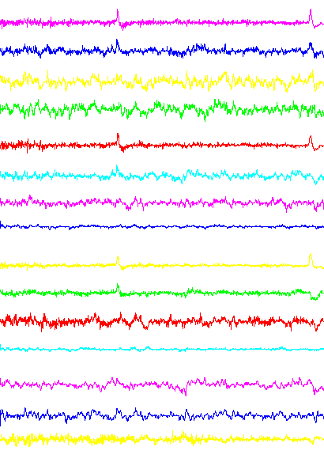
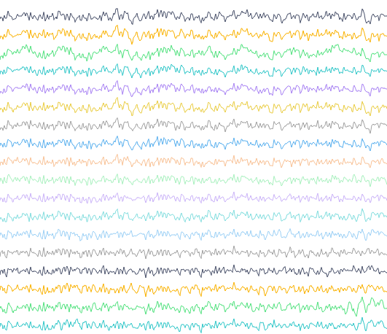



Signal Pretreatment
Common Feature Extractor
Subjects
δ
Physical Graph Connectivity
CWT
θ
×3
S¹
α
β
＋
γ
α
Concat
Adjacent Matrix (A)
＋
Pooling
Adaptive Graph Connectivity
1-α
GCN
BN
S^{i}
Channel
Attribute Graph
T
Fc:128-Dim
Time Window
Feature Matrix (X)
Reconstruction Matrix (X_{r})
Domain Specific
Classifier
mmd loss
Specific Feature Extractor
Key Feature Reconstruction (KFR)
cls loss
S¹
F_{sq}(·)
F_{ex}(·,w)
C¹
F¹
S^{i}
F_{scale}(·,·)
disc loss
LSD loss
average
Feature Matrix (X)
Reconstruction Matrix (X_{r})
Target label
train
T
test
cls loss
C^{i}
mmd loss
F^{i}

Slide 2
Before Adaptation
Multi-source domain
adaptation
`
`
`
`
`
`
`
`
`
`
`
`
`
`
`
`
`
`
`
`
`
`
source1:
source2:
`
target:
Spliting:

